Slide 1
Prepared by:
Dr. Muntadher Abdulkareem Abdullah
M.B.Ch.B,CABM,FIBMS,FIBMS(GE.&HEP.)

Slide 2
OBJECTIVES
At end of this lecture , you must be able to :
Know different types of GI bleeding ?
2. How you differentiate between different types of GI bleeding ?
3. What is the emergency managements of acute GI bleeding ?
4. What are the modalities of treatment of GI bleeding ?

Slide 3
A 69-year-old woman presents to the emergency department with 1 day history of melena. She has a history of rheumatoid arthritis, diabetes mellitus, and hypertension. Her medications include methotrexate, metformin, aspirin 81 mg, and ibuprofen 400 mg three times daily. On physical examination, her vital signs are as follows: Temperature 37° C Blood pressure 80/55 mm Hg Heart rate 120 bpm Respiratory rate 12 breaths/min Her abdominal exam is soft and non-tender. Laboratory values are as follows: Hemoglobin 8 g/dL WBC 7000/μL Platelet count 190,000/μL Total bilirubin 1.8 mg/dL Creatinine 1.5 mg/dL INR 1.3 She is adequately resuscitated with IV normal saline, and her blood pressure increases to 105/85 mm Hg and heart rate drops to 92 bpm. The emergency department physician starts an omeprazole drip. An endoscopy is planned in the morning.

Slide 8
A 58-year-old woman presents to the emergency department with light-headedness and a history of several bloody bowel movements over the past 24 hours. She denies any abdominal pain. She is hypotensive and anemic. Resuscitative measures are instituted. Both the upper endoscopy and colonoscopy are not diagnostic, but she continues to pass clots per rectum. Her hematocrit is 33%. What is the most effective management strategy?
A. Capsule endoscopy
B. Abdominal CT scan with contrast
C. Scintigraphy and angiography
D. MRI
E. Emergency surgery

Slide 10
A 57-year-old man with known chronic hepatitis C is brought by his wife to the emergency department, with two hours history of haematemesis and melena .
How you would continue with this patient ?

Slide 11
A 60-year-old man presents to the emergency department with 1 day history of hematemesis and melena. He has a history of osteoarthritis, diabetes mellitus, and hypertension. He has a remote history of hepatitis C, which was treated successfully in the 1990s. His medications include metformin, glimepiride, aspirin 81 mg, and ibuprofen 400 mg three times daily. On physical examination, his vital signs are as follows: Temperature 36° C Blood pressure 90/55 mm Hg Heart rate 110 bpm Respiratory rate 12 breaths/min His abdominal exam is soft and nontender. Laboratory studies are as follows: Hemoglobin 7.5 g/dL WBC 6000/μL Platelet count 290,000/μL Total bilirubin 1.4 mg/dL Creatinine 1.2 mg/dL INR 1.8 Which of the following recommendations is correct for this patient’s management?
A. IV octreotide should be started in the emergency department
B. Blood transfusion is indicated to a hemoglobin of at least 9 g/dL
C. Endoscopy should be delayed until the INR is corrected to 1
D. I.V. 0.9% NS

Slide 12
Gastrointestinal bleeding (GIB) can be :
Upper GIB :from the esophagus, stomach, and duodenum, this represent 50% of the GIB
Lower GIB :from the colon and anorectum , this represent 40% of the GIB
Obscure bleeding : from the small intestine , this represent 10% of the GIB
Gastrointestinal bleeding(GIB) can be :
Overt GIB :implies visible signs of blood loss from the GI tract ( hematemesis , coffee ground vomiting, melena and Hematochezia)
Occult GIB :GI bleeding refers to subacute bleeding that is not clinically visible, ( IDA)
Gastrointestinal bleeding (GIB) can be Obscure GI bleeding which is bleeding from a site that is not
apparent after routine endoscopic evaluation with esophagogastroduodenoscopy (upper endoscopy) and colonoscopy,
and possibly small bowel radiography.
Gastrointestinal bleeding (GIB) also can be either Acute or Chronic GIB.
Gastrointestinal bleeding (GIB) can be : Mild , Moderate or Severe.

Slide 13
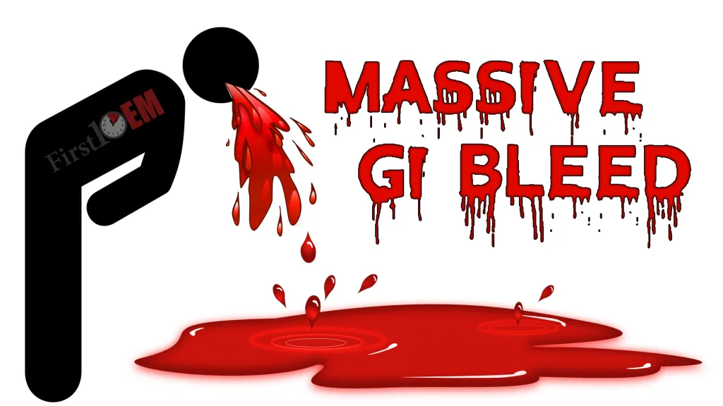
is defined as documented GI bleeding (hematemesis, melena, hematochezia, or positive
nasogastric lavage) accompanied by shock or orthostatic hypotension, a decrease in the hematocrit value by at least
6% (or a decrease in the hemoglobin level of at least 2 g/dL), or transfusion of at least 2 units of packed red blood
cells. Most patients with severe GI bleeding are admitted to the hospital for resuscitation and treatment.

Slide 14
INITIAL ASSESSMENT AND MANAGEMENT OF ACUTE GI BLEEDING
History:
Patients should be questioned about risk factors and historical features that help identify diagnostic possibilities for the
bleeding source.
Physical Examination:
On initial evaluation, physical examination should focus on :
1.The patient’s vital signs, with attention to signs of hypovolemia such as hypotension, tachycardia, and orthostasis.
2. The abdomen should be examined for surgical scars, tenderness, and masses.
3. Signs of chronic liver disease include spider telangiectasias (angiomata), palmar erythema, gynecomastia,
ascites, splenomegaly, caput medusae, and Dupuytren’s contracture.
4. The skin, lips, and buccal mucosa should be examined for telangiectasias, which are suggestive of hereditary
hemorrhagic telangiectasia (HHT), or Osler-Weber-Rendu Disease.
5. Pigmented lip lesions may suggest Peutz-Jeghers syndrome.

Slide 15
6. Purpuric skin lesions may suggest Henoch-Schönlein purpura.
7. Acanthosis nigricans may suggest underlying malignancy, especially gastric cancer.
8. The patient’s feces should be observed to identify melena or maroon and red stool; however, the subjective description
of stool color varies greatly among patients and physicians.
9. Nasogastric or orogastric tube placement to aspirate and visually characterize gastric contents can be useful for
determining the presence or absence of large amounts of red blood, coffee-ground material, or nonbloody ﬂuid.
Laboratory Studies:
Blood from the patient with acute GI bleeding should be sent for :
Standard Hematology : including CBC,PCV and MCV.
2. Standard biochemistry : including RFT , serum electrolytes .
3. Liver function test and coagulation profiles .
4. Blood for typing and crossmatching for packed red blood cells.
Important note is that The hematocrit value immediately after the onset of bleeding may not reﬂect blood loss accurately
because it takes over 24 to 72 hours for the vascular space to equilibrate with extravascular ﬂuid, and hemodilution results
from intravenous administration of saline.

Slide 16
Clinical Determination of the Bleeding Site :
Presentation with hematemesis, coffee-ground emesis, or nasogastric lavage with return of a large amount of blood or
coffee-ground emesis indicates a UGI source of bleeding.
Melena generally indicates a UGI source but can be seen with small intestinal or proximal colonic bleeding.
Hematochezia generally implies a colonic or anorectal source of bleeding unless the patient is hypotensive, which could indicate a severe, brisk UGI bleed with rapid transit of blood through the GI tract.
Maroon-colored stool can be seen with an actively bleeding UGI source or a small intestinal or proximal
colonic source.

Slide 17
Hospitalization:
Patients with severe GI bleeding require hospitalization, those with unstable vital signs or multiple underlying comorbid conditions with massive GIB should be admitted to the ICU.
Patients who have had an acute GI bleed but are hemodynamically stable can be admitted to a monitored bed (step-down unit) or standard hospital bed, depending on their clinical condition.
Those who present with only mild acute bleeding (self-limited hematochezia or infrequent melena) and who
are hemodynamically stable (not suspected to be volume depleted), have normal blood test results, and can be relied on
to return to the hospital if symptoms recur may be candidates for semiurgent outpatient endoscopy rather than direct admission to the hospital.
Many available scoring systems available can help determined the severity of associated GIB, need for intervention and determine the prognosis , of these scoring system are : The Blatchford and the Rockall score.

Slide 18
Resuscitation:
Resuscitation efforts should be initiated at the same time as initial assessment in the emergency department and continue during the patient’s hospitalization. And include the followings :
1.At least 1 large-bore (14-or 16-gauge) catheter should be placed intravenously, and 2 should be placed when the patient has ongoing bleeding.
2. Normal saline is infused as fast as needed to keep the patient’s systolic blood pressure higher than 100 mm Hg and pulse lower than 100/min.
3. Patients should be transfused with packed red blood cells, platelets, and fresh frozen plasma as necessary to keep the hemoglobin level
greater than 7 gm/dL, platelet count higher than 50,000/mm3, and prothrombin time less than 15 seconds, respectively.
4. Decisions about the timing of transfusion need to be individualized based on a patient’s clinical status and comorbidities and the rapidity of
blood loss.
5. Ongoing vital signs monitoring including urinary catheter insertion with urine out put monitoring for patient with active bleeding.
6. Endotracheal intubation should be considered in patients with active ongoing hematemesis or with altered mental status to prevent aspiration
pneumonia.

Slide 19
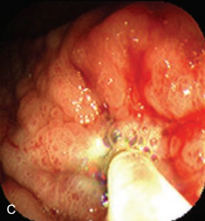
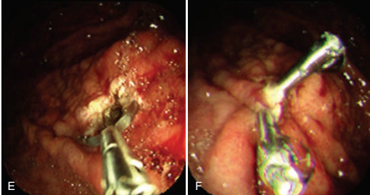
Initial Medical Therapy :
Administration of a PPI is useful for reducing rebleeding rates in patients with PUD.
Patients with a strong suspicion of portal hypertension and variceal bleeding should be started empirically on intravenous octreotide (bolus followed by infusion).
Endoscopy :
GI endoscopy will identify the bleeding site and permit therapeutic hemostasis in most patients with GI bleeding.
Endoscopy should be done only when it is safe to do so and when the information obtained from the procedure will inﬂuence
patient care.
Endoscopic Hemostasis :
For non variceal lesion This can include :
thermal contact probe.
2. Noncontact thermal therapy includes argon plasma coagulation and laser.
3. Injection therapy is most commonly performed with a sclerotherapy needle and submucosal injection of epinephrine, diluted to a concentration of 1 : 10,000 or 1 :20,000, into or around the bleeding site or stigma of hemorrhage.
4. Endoscopic hemoclips (or clips).
5. Hemostatic spray .
For variceal bleeding lesion this include :
Endoscopic rubber ligation
2. Injection Sclerotherapy.

Slide 20
Angiographic therapy :
by embolization of the bleeding vessel.
Surgery :
Indication for surgery in GIB:
Failure of endoscopic therapy.
2.When the source of the bleeding cannot be determined in patient with severe massive bleeding.
3. Patients who have massive hemorrhage and cannot be stabilized hemodynamically.

Slide 21
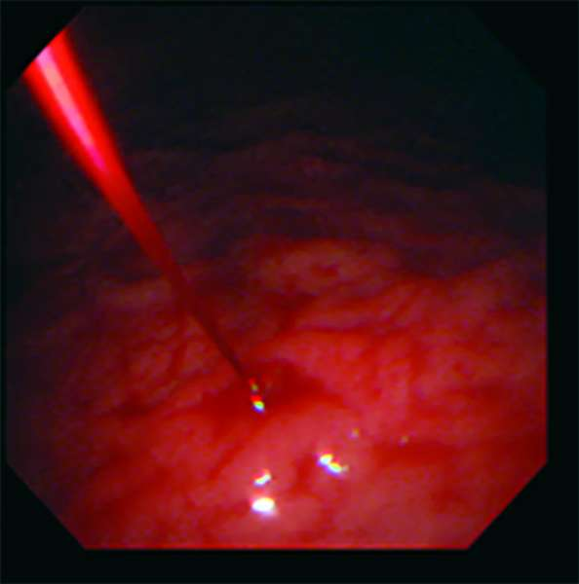
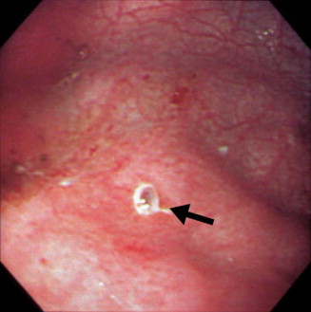
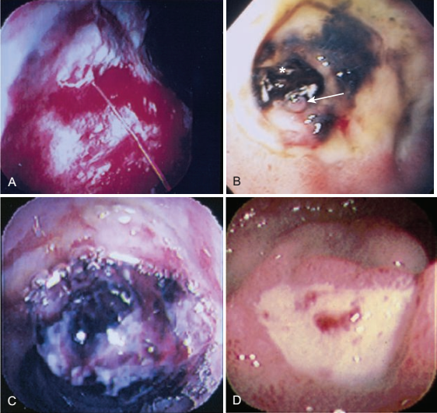
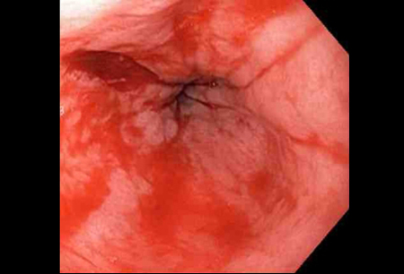
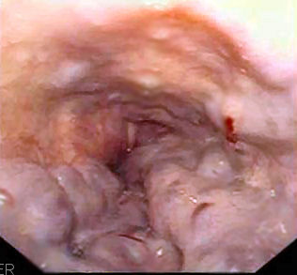
UPPER GI BLEEDING (UGIB) :
IS bleeding that is proximal to Ligament of Treitz.
Etiology of acute UGIB :
Peptic ulcer : 38%
2. Gastric or oesophageal varices : 16%
3.Oesophagitis : 13%
4.No cause found
5.UGI tumours
6.Angioectasia
7.Mallory-weiss tear
8.Erosions
9.Dieulafoy lesion
10.Others

Slide 22
Diagnostic and Therapeutic Approach:
History
Physical examination
Laboratory testing
Risk factor and Risk Stratification with medical resuscitation and empirical use of PPI or octreotide.
Endoscopic evaluation :
For both diagnostic and therapeutic purposes with the usage of endoscopic hemostasis techniques.
Angiography and Surgery:
Patients with recurrent bleeding despite 2 sessions of endoscopic hemostasis should be considered for angiographic embolization or surgical therapy.

Slide 23
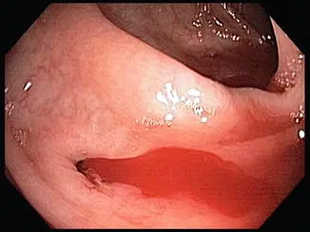
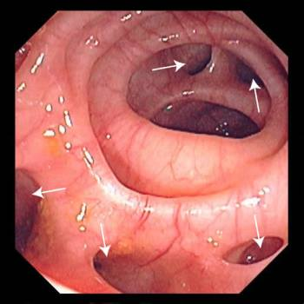
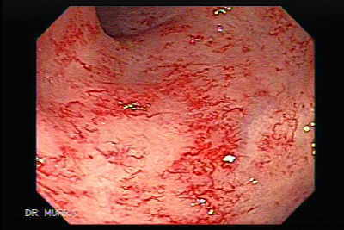
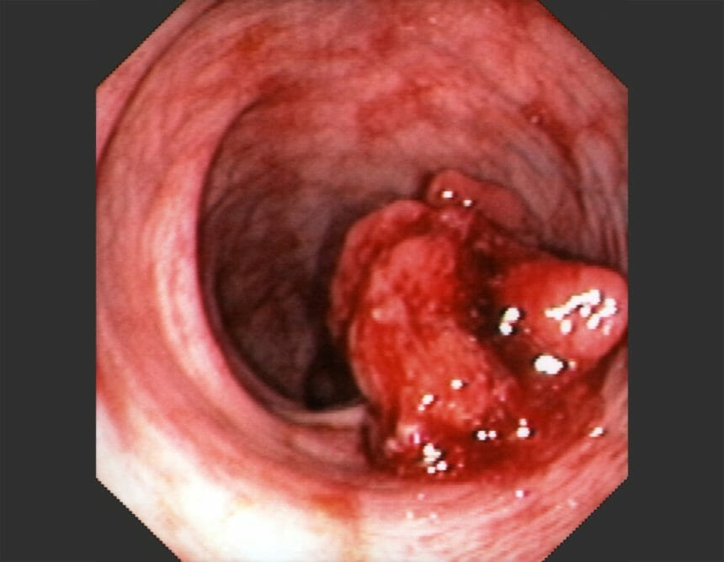
LOWER GI BLEEDING(LGIB):
It bleeding below ligament of Treitz , LGI bleeding generally signifies bleeding from the colon or anorectum.
Causes of Severe Hematochezia :
1.Diverticulosis : 30 %
2. Colon cancer or polyps : 18%
3. Colitis : 17 %
4. Ischemic colitis
5. IBD
6. Noninfectious colitis
7. Infectious colitis
8. Angioectasia
9. Postpolypectomy
10. Rectal ulcer
11. Hemorrhoids
12. Anorectal source (unspecifed)
13. Radiation colitis
14. Other
15. Unknown

Slide 24
Diagnostic and Therapeutic Approach:
History
Physical examination
Laboratory testing
Risk factor and Risk Stratification with medical resuscitation
Endoscopic evaluation : include the following :
Anoscopy :
Anoscopy can be useful for patients in whom actively bleeding internal hemorrhoids or other anorectal disorders (e.g., fissures, fistulas,
proctitis) are suspected and allows immediate treatment with rubber band ligation
2.Flexible Sigmoidoscopy:
Flexible sigmoidoscopy can evaluate the rectum and left side of the colon for a bleeding site and can be performed without a standard
colonoscopy bowel preparation.
An urgent ﬂexible sigmoidoscopy can be useful for patients suspected of having a solitary rectal ulcer, UC, radiation proctitis, ischemic
colitis, postpolypectomy bleeding (in the rectosigmoid), or internal hemorrhoids. It also can be therapeutics.
3. Colonoscopy :
Require bowel preparations and it is used for both diagnosis and treatment of proximal colonic lesions proximal to the splenic flexure.

Slide 25
4. Radionuclide Imaging:
Radionuclide imaging involves injecting a radiolabeled substance into the patient’s bloodstream and performing serial scintigraphy to detect focal collections of radiolabeled material
This technique has been reported to detect bleeding at a rate as low as 0.04 mL/min
Radionuclide imaging may be helpful in cases of obscure GI bleeding (see later) or prior to angiography to help localize a lesion, particularly if an early scan (e.g., 30 minutes to 4 hours after injection of the radiolabeled material) is positive for red blood cell extravasation.
5. Angiography:
It is invasive and involve the use of contrast media .
Angiography is most likely to detect a site of bleeding when the rate of arterial bleeding is at least 0.5 mL/min.
It is both diagnostic and therapeutic by embolization of the culprit vessel.
6. CT and CT Colonography:
Multidetector CT can identify abnormalities in the colon that could be a source of bleeding, such as diverticulosis, colitis, masses, and varices.
It involve the use of contrast medium and risk of radiation exposure.
7. Barium Enema :
This test is rarely diagnostic, because it cannot demonstrate vascular lesions and may be misleading if only diverticula are seen.
Emergency barium enema has no role in patients with LGI bleeding.
Medical and endoscopic treatment :
Most LGIB are self-limited and medical support involve the use of I.V. fluid and blood transfusion for resuscitation of patient with significant bleeding.
Endoscopic hemostasis include the use of endoscopic banding, thermal endoscopic therapy , injection therapy and hemostatic clipping of the culprit vessel.
Role of Surgery:
The main indications for surgery are malignancy, diffuse bleeding that fails to cease with medical therapy (as in ischemic or UC), and recurrent bleeding from a diverticulum.

Slide 26
OBSCURE GI BLEEDING:
Obscure GI bleeding is commonly defned as GI bleeding of uncertain cause after a nondiagnostic upper endoscopy, colonoscopy, and barium small bowel follow-through.
It can be either :
Overt obscure GI bleeding : refers to visible acute GI bleeding (e.g., melena, maroon stool, hematochezia) in patients with a nondiagnostic upper endoscopy, colonoscopy, and small bowel series.
Occult obscure GI bleeding : refers to a positive fecal occult blood test result, usually in association with unexplained iron defciency anemia
Causes of Obscure GI Bleeding:
Upper GI Tract:
Cameron’s lesions
Dieulafoy’s lesions
Gastric antral vascular ectasia
Small Intestine
Angioectasia
Aortoenteric fistula
Dieulafoy’s lesion
Diverticulosis
Meckel’s diverticulum
Neoplasm
Pancreatic or biliary disease
Ulceration
Colon
Angioectasia
Diverticulosis
Hemorrhoids
Varices

Slide 27
According to the patient age : Obscure GI bleeding can be attributed :
Below age of 40 years the cause is usually due to :
Small bowel tumor, Meckel’s diverticulum, or Crohn’s disease.
Above the age of 40 years the cause is usually due to :
Angioectasias or NSAID-induced ulcer.

Slide 28
Diagnostic approach of overt obscure GIB:
Overt Obscure GIB
positive
Repeat endoscopy if warranted Treat accordingly
Negative
Video capsule endoscopy ( after exclusion of possible bowel obstruction)
Positive
If the video capsule reveal :
Lesion in proximal jejunum push enteroscopy
2. lesion is found in the mid–small intestine deep enteroscopy or surgery
3. lesion in the terminal ileum retrograde enteroscopy via the colonic route
If the video capsule endoscopy is still not revealing intraoperative enteroscopy or surgery( especially in significantly symptomatic patient).

Slide 29
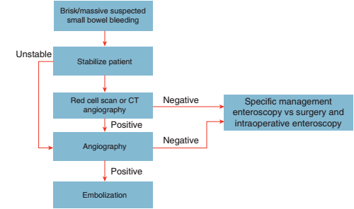
Approach to a patient with brisk/massive small bowel bleeding:

Slide 30
OBSCURE OCCULT GI BLEEDING:
These patients usually present with IDA.
Occult GI bleeding is usually detected with a routine guaiac based fecal occult blood test (FOBT) or fecal immunochemical test (FIT) and occurs (by definition) with no visible blood in the stool, with or without iron defciency.
The approach to the patient with a positive FOBT result depends on why the test was obtained.
If the FOBT or FIT was obtained for colon cancer screening in a patient 50 years of age or older colonoscopy or OGD
positive FOBT without IDA OGD
both negative
If a FOBT was performed for iron defciency anemia OGD and colonoscopy VCE possibly followed by
deep enteroscopy if a lesion is detected on capsule endoscopy.

Slide 31
Thanks

